Slide 1
Common Controls

Slide 2
LinkLabel Control
Allows you to add Web-style links to Windows Forms applications. You can use the LinkLabel control for everything that you can use the Label control for; you can also set part of the text as a link to a file, folder, or Web page.
Properties
Text - text displayed on the linklabel
LinkArea: select some area to serve as a hyperlink
Link Visited: changes color once it is clicked

Slide 3
Demo
private void linkLabel1_LinkClicked(object sender, LinkLabelLinkClickedEventArgs e)
{
Using.System.Diagnostics.Process.Start(new ProcessStartInfo {
FileName = "C:\\Users\\mihir\\Downloads\\Telegram Desktop", UseShellExecute = true
});
}

Slide 4
Common DialogueBox
A dialog box in C# is a type of window, which is used to enable common communication or dialog between a computer and its user
A dialog box is most often used to provide the user with the means for specifying how to implement a command or to respond to a question.
Windows.Form is a base class for a dialog box.

Slide 5
Code snipplet
DialogResult res = MessageBox.Show("Are you sure you want to Delete", "Confirmation", MessageBoxButtons.OKCancel, MessageBoxIcon.Information);
if (res == DialogResult.OK)
{ MessageBox.Show("You have clicked Ok Button"); //Some task… }
if (res == DialogResult.Cancel)
{ MessageBox.Show("You have clicked Cancel Button"); //Some task… }

Slide 6
Common dialog box
The dialog boxes that are used, which are common to all Windows Application. It performs common tasks like saving a file, choosing a font etc.
The examples are given below.
FontDialog
ColorDialog
OpenDialog
SaveDialog

Slide 7
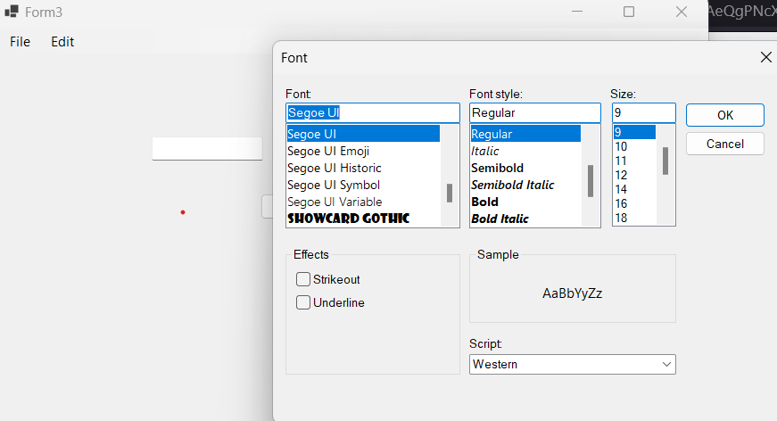
Font DialogBox
Allows you to select font size, font style and fond type for text displayed on controls.
private void fontToolStripMenuItem_Click(object sender, EventArgs e)
{
FontDialog fg = new FontDialog();
fg.ShowDialog();
textBox1.Font = fg.Font;
}

Slide 8
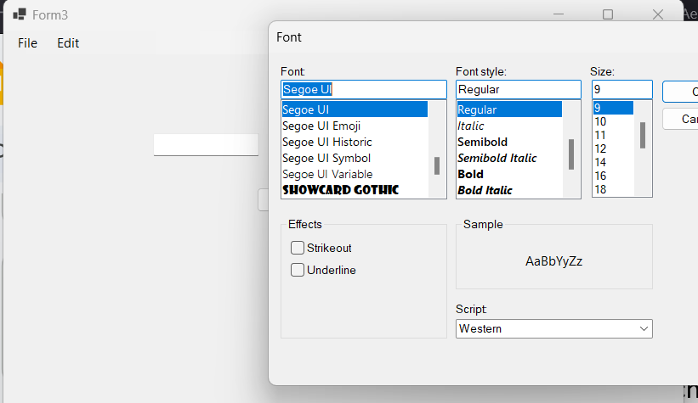
Color Dialog Box
Allows you to choose background and foreground color for controls
private void colorToolStripMenuItem_Click(object sender, EventArgs e)
{
ColorDialog cd = new ColorDialog();
cd.ShowDialog();
textBox1.ForeColor = cd.Color;
}

Slide 9
Save DialogueBox
The SaveFileDialog box is used to allow the user to select the destination and name of the file to be saved.
SaveFileDialog sfd = new SaveFileDialog();
sfd.Filter = "Text fiie|*.txt";
if (sfd.ShowDialog() == DialogResult.OK)
{
string path = sfd.FileName;
System.IO.BinaryWriter bw = new System.IO.BinaryWriter(System.IO.File.Create(path));
bw.Write("Example text");
bw.Dispose();
}

Slide 10
OpenFileDialoguebox
The OpenFileDialog allows you to choose a file to be opened in an Application.
OpenFileDialog ofd = new OpenFileDialog();
if (ofd.ShowDialog() == DialogResult.OK)
{
MessageBox.Show(ofd.FileName);
}

Slide 11
PictureBox Control
PictureBox class represents a Windows picture box control for displaying an image.
Properties
Image: Gets or sets the image that is displayed by PictureBox.
ImageLocation: Gets or sets the path or URL for the image to display in the PictureBox.

Slide 12
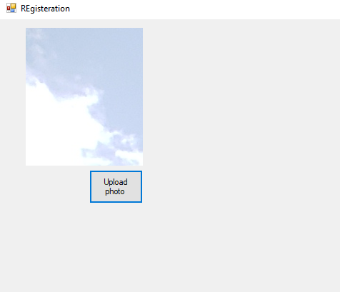
Exercise
Write an application that lets the user upload pictures in your program.

Slide 13
ListBox
The ListBox control allows the user to view and select from multiple items in a list.
ListBox is a static GUI entity, which means that users cannot directly edit the list of items Properties
Items: collection of items in the ListBox
MultipleItems: indicates whether the listbox can display multiple columns.
SelectedIndex: returns the index of the selected item.
Sorted: sorts the items in the listbox alphabetically.
SelectedIndexChanged(Event): Generated when the selected index changes. This is the default event when the control is double clicked in the designer.

Slide 14
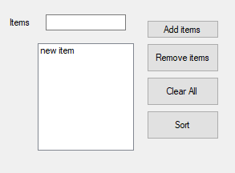
Demo
This is a demo app that has a list box and four buttons for adding, removing, clearing and sorting listbox items.

Slide 15
Cont
private void add_btn_Click(object sender, EventArgs e)
{ listBox1.Items.Add(textBox1.Text);
private void remove_btn_Click(object sender, EventArgs e)
{ listBox1.Items.RemoveAt(listBox1.SelectedIndex); }
private void clearall_btn_Click(object sender, EventArgs e)
{listBox1.Items.Clear(); }

Slide 16
CheckedListBox
The CheckedListBox control derives from ListBox and displays a CheckBox with each item.
Items can be added via methods Add and AddRange or through the String Collection Editor(similar to ComboBox, ListBox).
CheckedListBoxes allow multiple items to be checked, but item selection is more restrictive.
Selection Mode: One or none effectively switches between enabling and disabling the user’s ability to check list items.

Slide 17
Common Properties and Events
CheckedItems: Accessible only at runtime. Returns the collection of items that are checked as a CheckedListBox.CheckedItemCollection.
CheckedIndices: Accessible only at runtime. Returns indices for all checked items as a CheckedListBox.CheckedIndexCollection.
Methods
GetItemChecked(): takes an index and returns true, if the corresponding I
Events
ItemCheck: generated when an item is checked.

Slide 18
ItemCheckEventArgs Properties
CurrentValue: indicates whether the current item is checked or unchecked. Possible values are checked, unchecked and indeterminate.
Index: returns returns the zero based index of item that changed.
NewValue: specifies the new state of the item.

Slide 19
Demo
The following example uses a CheckedListBox and a ListBox to display a user’s selection of books.
The CheckedListBox named inputCheckedListBox allows the user to select multiple titles.
Using String Collection Editor add the following items:
C++, Java, VB, Internet & WWW, Perl, Python, Wireless Internet and Advanced Java.
The ListBox, named displayListBox – displays the user’s selection.
In the screen shots accompanying this example, the CheckedListBox appears to the left, the ListBox to the right.

Slide 20
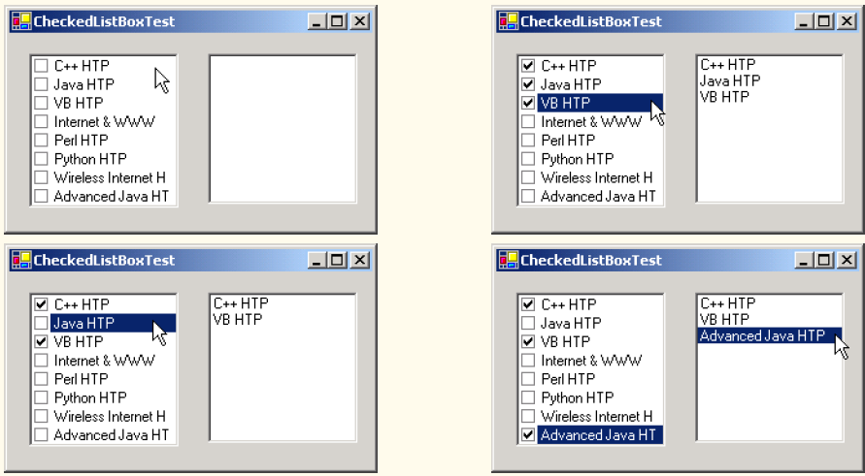

Slide 21
How does it work?
When the user checks or unchecks an item in CheckedListBox inputCheckedListBox, the system generates an ItemCheck event.
Event handler inputCheckedListBox_ItemCheck handles the event.
An if/else control structure determines whether the user checked or unchecked an item in the CheckedListBox.
The program uses the NewValue property to test for whether the item is being checked (CheckState.Checked).
If the user checks an item, adds the checked entry to the ListBox displayListBox.
If the user unchecks an item, line 41 removes the corresponding item from displayListBox.

Slide 22
Cont
// item about to change, add or remove from displayListBox
private void inputCheckedListBox_ItemCheck( object sender, System.Windows.Forms.ItemCheckEventArgs e )
{
// obtain reference of selected item
string item = inputCheckedListBox.SelectedItem.ToString();
// if item checked add to listbox otherwise remove from listbox
if ( e.NewValue == CheckState.Checked )
displayListBox.Items.Add( item );
else
displayListBox.Items.Remove( item );
}

Slide 23
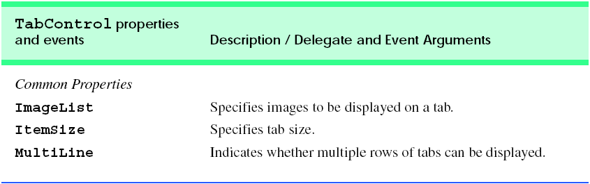
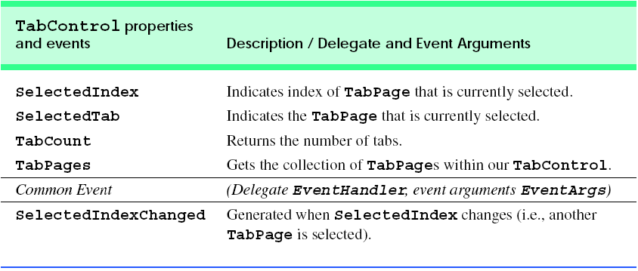

Slide 24
Mouse EventHandling

Slide 25
Mouse events
Mouse events are generated when the user interacts with a control via the mouse.
Mouse events can be handled for any control that derives from class System.Windows.Forms.Control. For most mouse events, information about the event is passed to the event-handling method through an object of class MouseEventArgs.
The delegate used to create the mouseevent handlers is MouseEventHandler.

Slide 26
Mouse Events and EventArgs
Mouse Events with Event arguments of EventArgs
MouseEnter: mouse cursor enters the control’s boundaries
MouseHover: mouse cursor hovers within the control’s boundaries
MouseLeave: mouse leaves the control’s boundaries.
Mouse events with Event Arguments of MouseEventArgs
MouseDown:mouse button is pressed within the boundaries of the control
MouseMove:mouse cursor is moved within the boundaries of the control
Mouse button is pressed while the mouse cursor is within a control’s boundaries.

Slide 27
Cont.
MouseUp: mouse button is released when the cursor is over the control’s boundaries
MouseEventArgs Properties
Button: specifies which button is pressed(Left, Right,Middle,None)
Clicks: the number of times the mouse is clicked
X: the x-coordinate within the control where the event occurred
Y: the y-coordinate within the control where the event occurred.

Slide 28
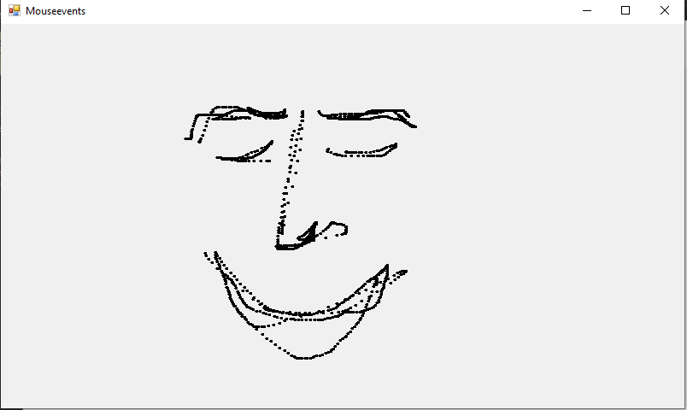
Demo: PaintApp

Slide 29
Code
public partial class Mouseevents : Form
{
bool shouldpaint = false;//whether to paint or not
public Mouseevents()
{ InitializeComponent(); }
private void Mouseevents_MouseDown(object sender, MouseEventArgs e)
{ shouldpaint = true; }

Slide 30
Cont.
private void Mouseevents_MouseUp(object sender, MouseEventArgs e) { shouldpaint = false; }
private void Mouseevents_MouseMove(object sender, MouseEventArgs e)
{ if(shouldpaint)
{
using (Graphics graphics = CreateGraphics())
{
graphics.FillEllipse(new SolidBrush(Color.Black), e.X, e.Y, 4, 4);
} }
}

Slide 31
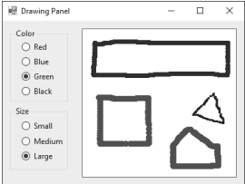
Exercise(Due December 2)
(Enhanced Painter) Extend the program of Fig. 14.38 to include options for changing the size and color of the lines drawn. Create a GUI similar to Figure below The user should be able to draw on the app’s Panel. To retrieve a Graphics object for drawing, call method panelName.CreateGraphics(), substituting in the name of your Panel.

Slide 32
DateTimePicker Control
The DateTimePicker can be used to retrieve date and time information from the user.
A DateTimePicker’s Value property stores a DateTime object, which always contains both date and time information.
You can retrieve the date information from the DateTime object by using property Date, and you can retrieve only the time information by using the TimeOfDay property.

Slide 33
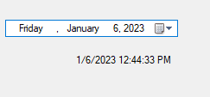
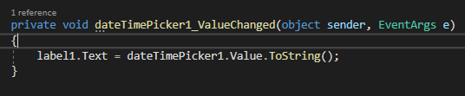
Cont.
The following program displays the selected date and time on a label.
Property Format specifies the user’s selection options using the DateTimePickerFormat enumeration.
The values in this enumeration are Long (displays the date in long format, as in Thursday, July 10, 2013), Short (displays the date in short format, as in 7/10/2013),

Slide 34
Properties and Events
Properties
Value: the data that is selected by the user
MaxDate: maximum date that can be selected
MinDate: minimum date that can be selected.
Format: sets the format of the date and/or time used for the date and/or time displayed In the control.
Events
Value Changed: generated when the Value property changes, including when the user selects a new date and time.

Slide 35
Tab
The TabControl control creates tabbed windows, such as those we have seen in the Visual Studio .
This allows the programmer to design user interfaces that fit a large number of controls or a large amount of data without using up valuable screen “real estate.”
TabControls contain TabPage objects, which are similar to Panels and GroupBoxes in that TabPages also can contain controls.

Slide 36
Cont.
The programmer first adds controls to the TabPage objects, then adds the TabPages to the TabControl.
Only one TabPage is displayed at a time. Figure 13.26 depicts a sample TabControl.
Programmers can add TabControls visually by dragging and dropping them onto a form in design mode.
To add TabPages in the Visual Studio .NET designer, right-click the TabControl, and select Add Tab
Alternatively, click the TabPages collection in the Properties window, and add tabs in the dialog that appears.

Slide 37
Cont.
Note that clicking the tabs selects the TabControl—to select the TabPage, click the control area underneath the tabs.
The developer can add controls to the TabPage by dragging and dropping items from the ToolBox.
To view different TabPages, click the appropriate tab (in either design or run mode).

Slide 38
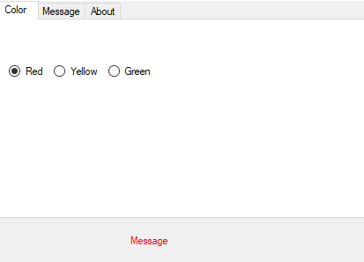
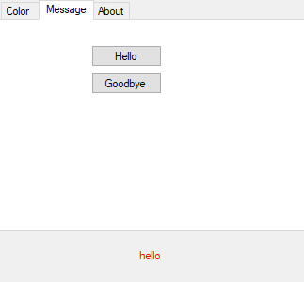
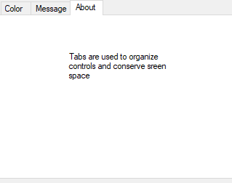
Demo

